Slide 1




Ethnobotany
Cory Whitney
cory.whitney@uni-bonn.de

Slide 2
Ethnobotany Workshop Aims
Ethnobotany
Programming
Experiential
Addressing decisions & developing hypotheses
Performing analyses in the R environment with ethnobotanyR
Doing fieldwork
Effective ethnobotanists

Slide 3


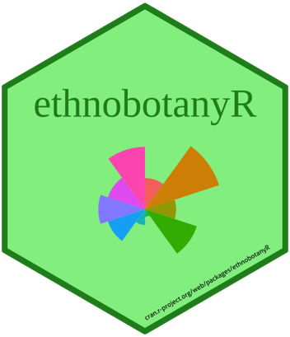
Workshop tools
Ethnobotany
Programming
Experiential
R https://cran.r-project.org/
RStudio https://www.rstudio.com/products/rstudio/download/#download
ethnobotanyR install.packages("ethnobotanyR")

Slide 4
Reading Materials
Ethnobotany
Programming
Experiential
Albuquerque et al. 2019. Biological Theory. doi:10.1007/s13752-019-00316-8.
Gaoue et al. 2017. Economic Botany 71: 269–287. doi:10.1007/s12231-017-9389-8.
Tardio & Pardo-de-Santayana, 2008. Economic Botany, 62(1), 24-39. https://doi.org/10.1007/s12231-007-9004-5.
Whitney et al. 2018. Ethnobiology Letters, 9(2), 90-100. https://doi.org/10.14237/ebl.9.2.2018.503

Slide 5
Ethnobotany workshop outline
Ethnobotany
Programming
Experiential
Morning (classroom)
Afternoon (practical)
16
Intros
R
17
Ethnobotany
Decision Analysis
18
R environment
ethnobotanyR
Field work
Hypotheses and objectives
Practice with own data
19
20

Slide 6
Quantitative ethnobotany analysis with ethnobotanyR
http://htmlpreview.github.io/?https://github.com/CWWhitney/ethnobotanyR/blob/master/vignettes/ethnobotanyr_vignette.html
ethnobotanyR install.packages("ethnobotanyR")

